Slide 1


A Finite Resource: Managing the Growing Water Needs of Data Centers, Critical Minerals Mining, and Agriculture
Helena Volzer, Senior Source Water Policy Manager, Alliance for the Great Lakes

Slide 2
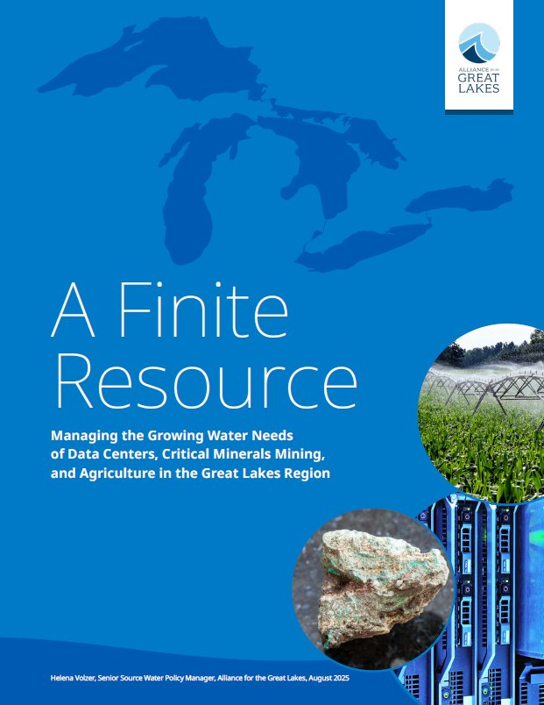
Three sectors of the report
Data centers
Critical minerals mining
Agriculture

Slide 3
Regional Playbook
Follow up to our August 2025 report
Met with CBOs, state advocates
Interconnected freshwater system
Cumulative effects; need for both a state and regional approach
Speed

Slide 4
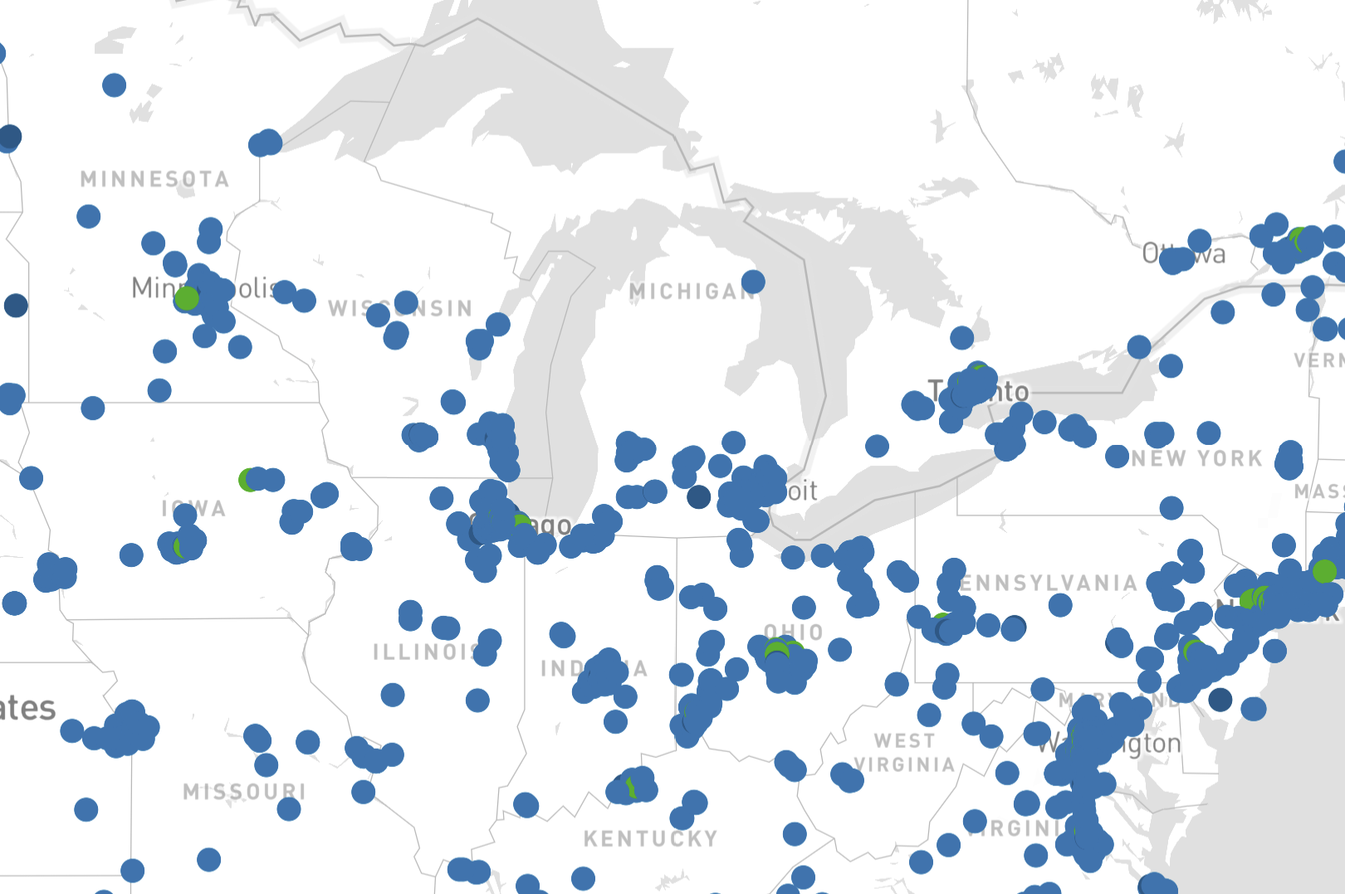
Source:
Datacentermap.com
2/5/26

Slide 5
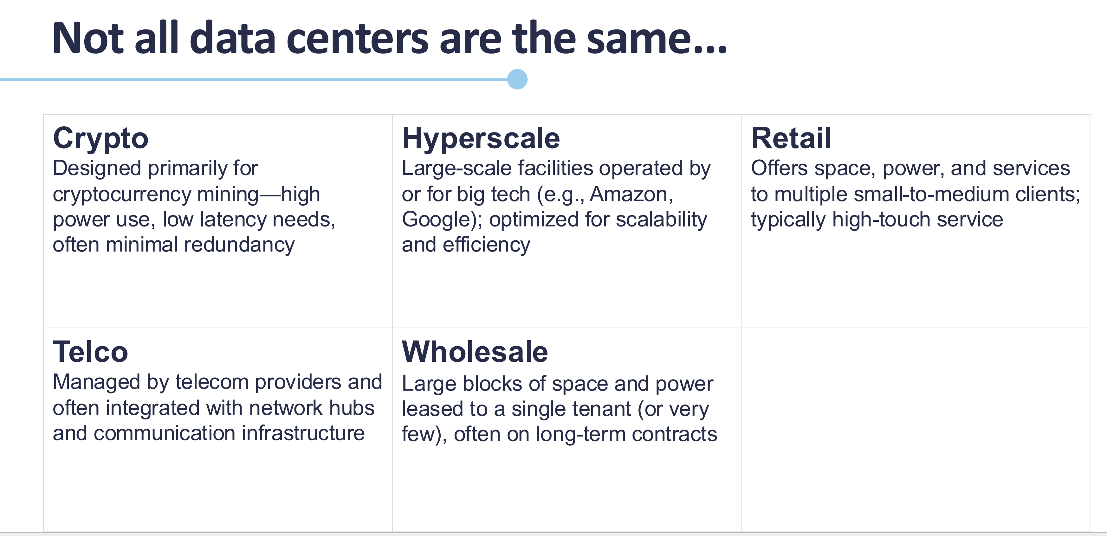
Credit: UVA Weldon Cooper Center

Slide 6

Hyperscale data centers
Gen AI, cloud computing, IoT, crypto, and digital services are driving unprecedented demand for data centers
GenAI requires vast data processing capabilities that only hyperscale can handle
Hyperscale: In the Great Lakes region, about 325,000 sq ft, 46 MW (about the size of one third of Millenium Park in Chicago)
Evaporative cooling – 1 to 5 MGD; A data center using 1 MGD for a year = 12,000 Americans

Slide 7
Cooling methods data centers use
Evaporative cooling – high consumptive water use but more energy efficient
Liquid immersion and direct to chip – directly immerse equipment
Closed loop – water and coolant delivered to server racks in a closed loop. Lower water use, but energy use can be substantial
Air cooling – insufficient alone for the needs of AI

Slide 8
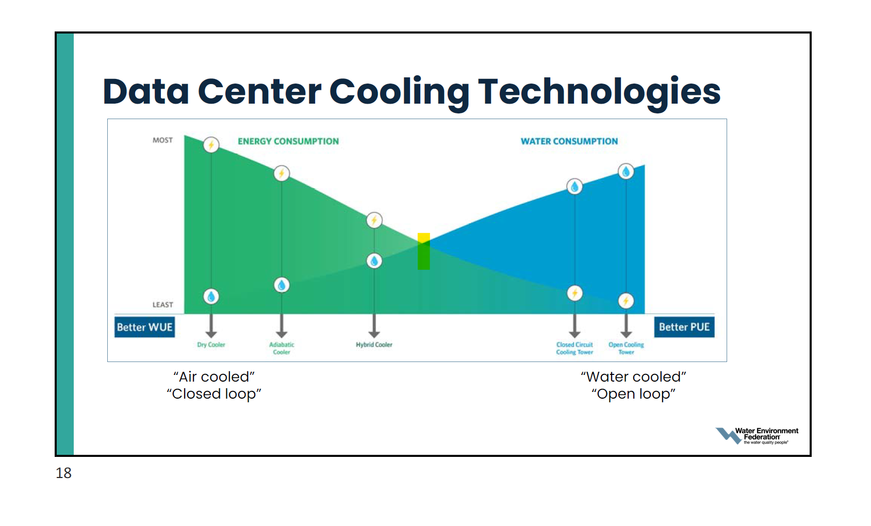
Credit: Water Environment Federation

Slide 9
Perspective: indirect water use
Indirect water use by a hyperscale data center using closed loop can be substantial
Example: Vantage data center in Port Washington, WI
  3.5 GW at full build out (no info on seasonal variation/hourly use)
  That varies both by fuel type and cooling method but on average could equate to:
    Coal – 66 MGD – 1.2 B GPD withdrawn, 26 – 52 MGD consumed
    Natural Gas – 54 MGD – 1.9 B GPD withdrawn, 14 - 39 MGD consumed
    Nuclear – 92 MGD – 3.7 B GPD withdrawn, 22 – 56 MGD consumed
  Natural gas withdrawal of 54 MGD = 970,000 Wisconsinites – more than 2x every home, business, and manufacturer in Green Bay
Credit:
Clean Wisconsin

Slide 10
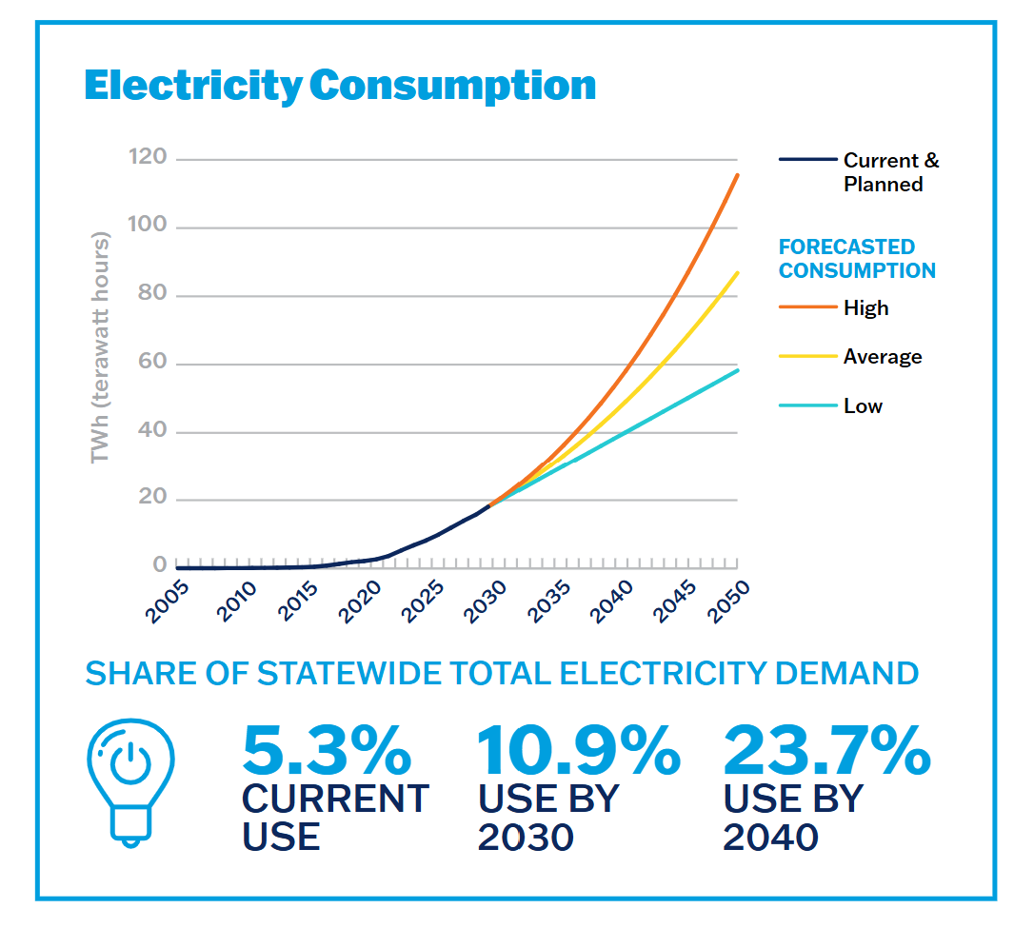
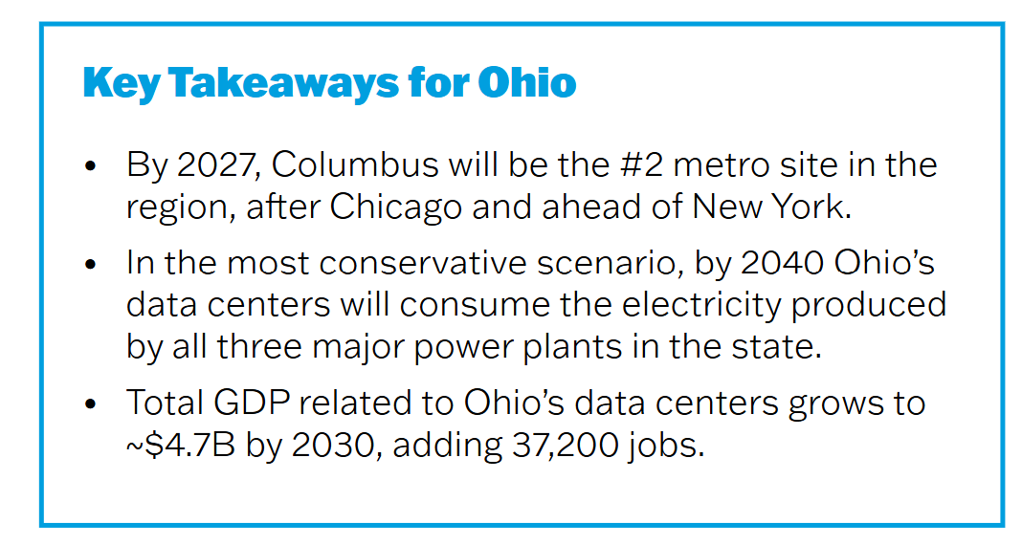
Ohio: Data center energy consumption
Credit: UVA Weldon Cooper Center

Slide 11
Gaps
What is the total water use footprint of a data center? We don't really know.
  Unless the data center itself is withdrawing water, registration and consumptive use permit requirements don't apply - no reporting requirements where users hook into municipal water systems
  Less than 1/3 are tracking water use – no requirement to do so
  Electricity from coal, gas, and nuclear also needs water – and we don't know and can't calculate how much of that water use is driven by data centers
  NDAs can obscure how much water a project is proposing to use at the outset

Slide 12
Great Lakes – St. Lawrence River Basin Water Resources Compact
Generally prohibits diversions (transfer to another watershed)
Requires states to manage Great Lakes water use within the Basin
Sets water conservation and efficiency goals, objectives, programs
Establishes common water use reporting protocols
Per the Compact, programs:
“need to adjust to new demands and the potential impacts of cumulative effects and climate"

Slide 13
Development process
Economic development teams site the project
Municipality approached to evaluate land, power, and water use
Concerns raised by public, legislators, water managers
Agreements are reached: public
Water managers and regional planners usually not involved
NDAs
Land and power needs first
Partners approached with short timeline
Municipal water supply connection
Credit: Freshwater.org

Slide 14
Environmental and community impacts
Rising electric utility rates; potential for this to occur with water and wastewater as well
  Water pressure drops – can stress water mains at peak times, causing breaks and introducing contamination
Noise, air, and light pollution
E-waste – replacing server equipment every 3-5 years
Fire risks; strain on emergency services
Low direct employment, high resource use

Slide 15
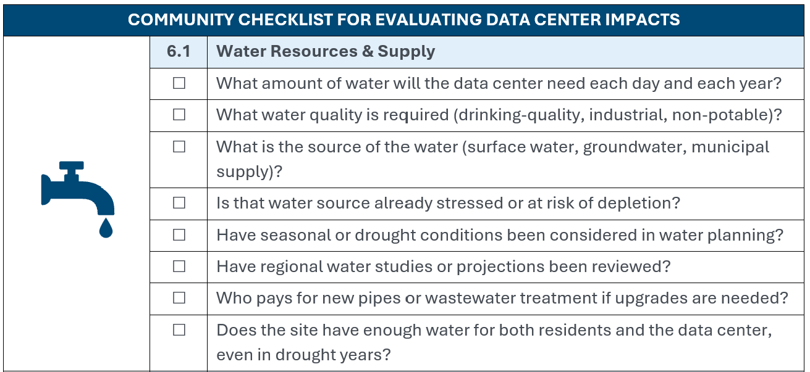
Community checklist

Slide 16
What you can do locally
Ask for documents - resources for making public records requests
Community Benefit Agreements – checklist for what to include
Examples: municipal ordinances and zoning; temporary moratoria
Participation in local hearings and meetings on proposals – how to come prepared and responses you may encounter

Slide 17
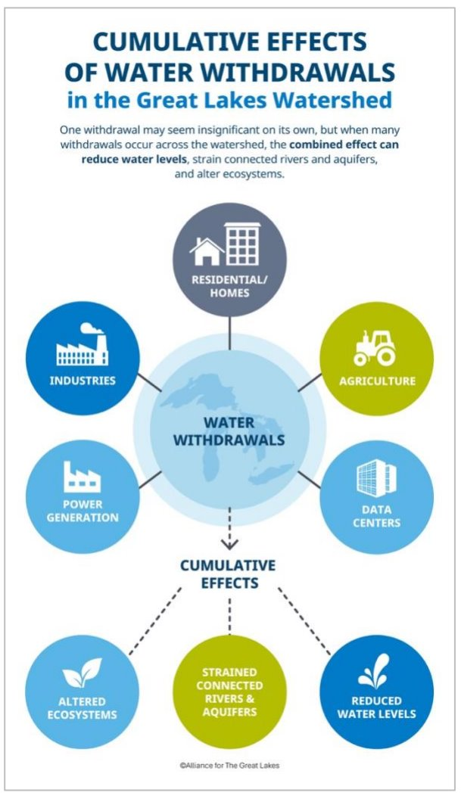
Why local solutions alone aren't enough
Threat to groundwater integrity – convergence of demand
  Existing groundwater conflicts
Water/energy nexus
State level economic development corporations may make decisions without local input
Local temporary moratoria or restrictions create a patchwork
  Community benefit agreements are one tool
State legislatures may respond
  Example: Ohio HB 392 – severely limits local and state control over data center regulation
    Enacted: MT SB 212

Slide 18
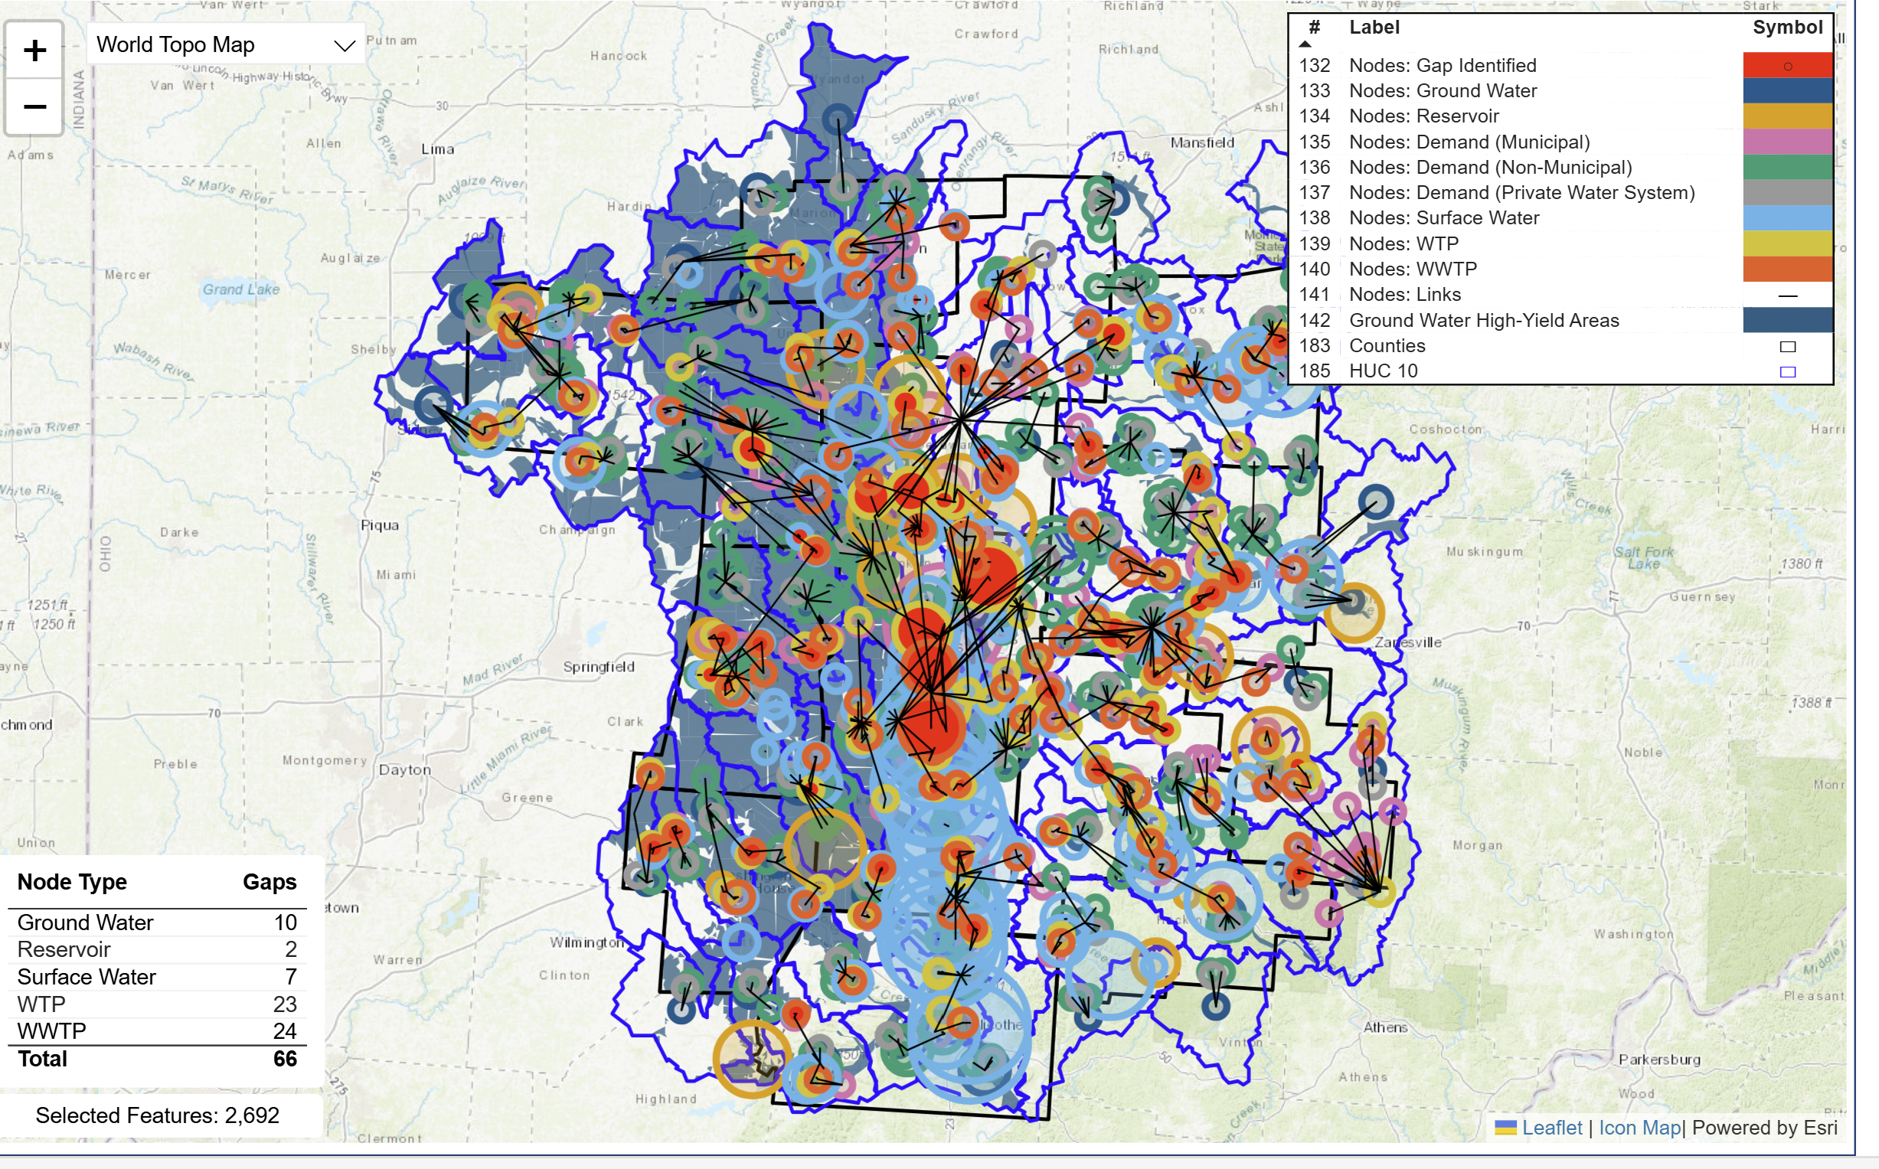
Policy solutions: state
Planning – regional demand studies – OH, IL, IN
  Incorporate as an ongoing part of conservation programs vs. one-off projects
  Evaluate ecosystem and environmental needs as part of demand
  Economic development agencies and local governments should turn to these studies when siting and incentivizing new projects
Central Ohio Regional Demand Study

Slide 19
Policy solutions: state
Transparency and accountability – NJ & CA
  Disclosure and water use reporting requirements for large water users -irrespective of municipal supply connection
  Community benefit agreements – involve the community in decision making–pushback and moratoria
  Tax incentives and abatements – eliminate or connect with water use; OH and MI
Efficiency standards for data centers - CT
  Recirculation, co-location with WWTP, use of non-potable water

Slide 20
Ohio Activity
OEPA General NPDES permit for data centers; 7500 comments
HB 96 (main operating budget) - sales and use tax incentive repeal – veto override
HB 646 – Data Center Study Commission – likely enacted by end of the month
HB 695 – prohibit all NDAs (2 Rs)
HB 710 – prohibit public support, limit data center construction (2 Rs)
Suite of D bills including:
  Includes one requiring water use reporting and prohibiting consumptive use > 5 MGD
  Bills that reaffirm home rule

Slide 21
What the Alliance is working on
Leading a convening of partners
Playbook for communities facing large water use proposals
Educating lawmakers across the region
Meetings and working groups we participate in:
  WateReuse Association (Ohio chapter)
  Michigan Water Use Advisory Council
  Great Lakes Compact Council and Regional Body meetings

Slide 22
What you can do
Subscribe to our newsletter at greatlakes.org - action alerts and our activities across the region
Share the playbook for communities facing large water use proposals
Educate local and state elected officials regarding the importance of proper surface and groundwater management
Submit testimony for hearings on data center legislation
Keep in touch!
  Hvolzer@greatlakes.org

Slide 23
Learn more
To learn more about the Alliance, the increasing demand for water in the Great Lakes region, and these policy solutions, visit:
Greatlakes.org/wateruse
  Report
  Factsheet
  Webinar
  Playbook

